Slide 1

RippleOps
AI BUILDER CUP 2026 · FUTURE OF WORK & ENTERPRISE PRODUCTIVITY
See the ripple before it hits your business.
The AI change-impact agent for manufacturing and supply chains.
Proposal · October 2026
Notes:
RippleOps is an AI change-impact agent for manufacturers. When a supplier discontinues a part or costs move, it traces the change through every product, prices the impact, and hands each team an action plan.

Slide 2
Supply chains change constantly. Decisions still take days.
THE PROBLEM
PROCUREMENT
ENGINEERING
FINANCE
Which part numbers are affected?
Where is it in the BOM, and how many per product?
How far do cost and margin move?
PRODUCT
SUPPLY CHAIN
SALES
Is there an approved alternative?
How long will inventory last?
Which customers and quotes are exposed?
Every answer exists somewhere in the company. Nobody sees them together until the meeting.
RippleOps · AI Builder Cup 2026
02
Notes:
When a component is discontinued, gets more expensive, or is hit by commodity or freight changes, the questions are simple but the answers are spread across six teams and several systems. Today that means spreadsheets, e-mail and a meeting, and it often takes days.

Slide 3
Disruption is no longer the exception. It is the operating environment.
WHY NOW
52%
45%
26,225
$210B
of electronic parts discontinued in 2025 had no end-of-life notice
of one year's profits lost to supply disruptions over a decade, on average
supply chain disruption alerts in 2025, up from 22,522 in 2024
auto industry revenue lost to the 2021 chip shortage
Z2Data, 2026 · 323,286 of 621,909 parts
McKinsey Global Institute, 2020
Resilinc EventWatch, 2024 and 2025
AlixPartners forecast, Sept 2021
Third-party figures; sources in speaker notes
03
Notes:
Parts are discontinued at scale, and more than half without warning. Disruptions are frequent and expensive, and a single missing chip can stop whole product lines. Sources: Z2Data, "Components Are Going EOL Without Product Change Notifications at Alarming Rates" (March 2026), z2data.com. McKinsey Global Institute, "Risk, resilience, and rebalancing in global value chains" (August 2020), mckinsey.com. Resilinc, 2024 disruption press release (January 2025) and "Illumination: 2025 Annual Supply Chain Report", resilinc.ai. AlixPartners press release forecasting $210B in 2021 auto revenue lost to semiconductor shortages (September 2021), alixpartners.com.

Slide 4
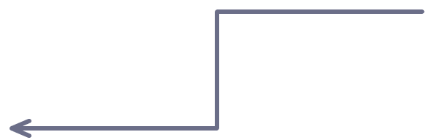
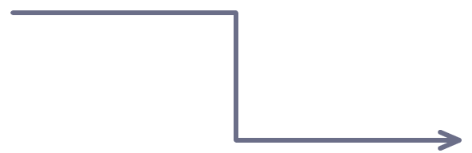



One part. Twelve products. $4.2M at risk.
WHY IT IS HARD
P300
Edge Controller Pro
×1
×2
ASM-A200
ASM-B300
Dual-Core Board
I/O Expansion Board
One discontinued chip reaches Edge Controller Pro (P300) through two assembly paths: 4 chips per unit.
×2
×1
SUB-C100
(1 × 2 × 1) + (2 × 1) = 4
MCU Core Module
×1
RippleOps works this out for every product, automatically.
MCU-X100
End-of-life notice
Demo data is fictional
04
Notes:
The challenge is not looking up a part number. A part can sit several levels down and appear through more than one path, so the real quantity per product has to be computed. In our demo, P300 reaches MCU-X100 twice through the dual-core board (which holds two core modules) and twice through its two I/O boards, so 4 chips per unit. Across all 12 affected products, that is $4.2M of revenue in the next six months.

Slide 5
Every manufacturer sees the full ripple of a change, and acts, before it reaches a customer.
OUR VISION
CHANGE
TRACE
CALCULATE
SOURCE
RE-PLAN
DECIDE
ACT
Gemini reads the notice
BigQuery Graph walks every BOM level
Cost, margin, revenue and stock coverage
Agents vet and score alternate suppliers
OR-Tools re-plans production
A person approves the plan
Actions for every team
From supplier notice to approved plan, in one flow.
RippleOps · AI Builder Cup 2026
05
Notes:
This is the Future of Work angle: instead of six people reconciling spreadsheets, an agent team does the tracing and arithmetic, and people spend their time on the decision. RippleOps is an enterprise decision and collaboration agent, not a chatbot.

Slide 6
The full business impact, before the first meeting
DEMO SCENARIO · MCU-X100 END-OF-LIFE
12
$4.2M
58 days
4
affected SKUs in 3 product families
revenue exposed over the next 6 months
of MCU-X100 inventory left
products with no approved alternative
WHAT IF WE SWITCH TO MCU-X200?
AND COPPER +12%, FREIGHT +15%?
+18% part price, +$4.73 unit cost, −1.9 pts margin. 3 products fall below the 20% target.
Copper and Taiwan-to-US ocean freight stack on top. 5 products fall below target.
Fictional seeded dataset · figures asserted by automated tests
06
Notes:
This is the demo story. A fictional supplier, NovaChip, announces end-of-life for MCU-X100 with a last-time buy on January 30, 2027. Within one screen the user sees the scope, the money at risk and how long stock lasts, then runs what-if scenarios. Unit cost and margin changes are averages across affected products.

Slide 7
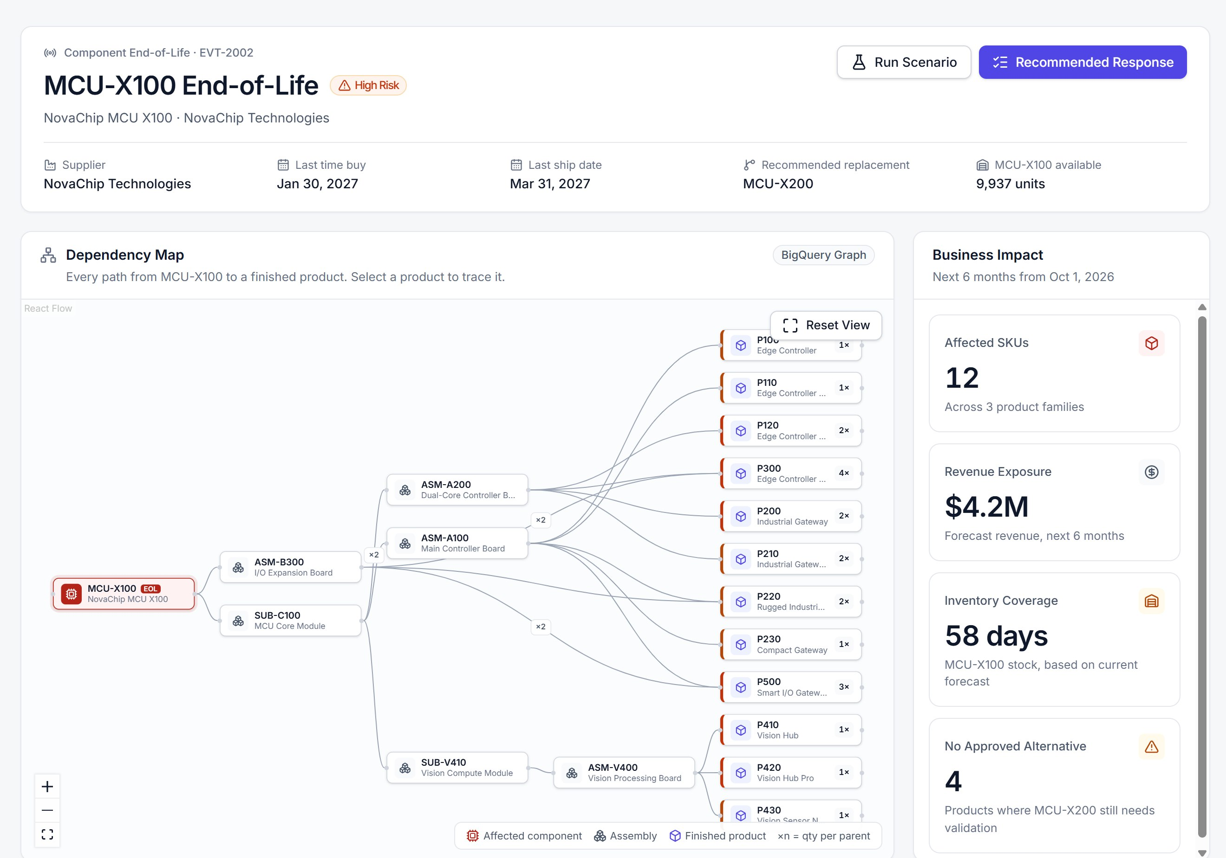
See the whole ripple
PRODUCT · IMPACT ANALYSIS
BigQuery Graph traces every path from part to product
Exposure, stock coverage and missing alternates, at a glance
Select any product to see why it matters
Live product on Google Cloud · fictional demo data
07
Notes:
This is the live Impact Analysis screen. The dependency map shows every path from MCU-X100 to the 12 finished products, with quantity per parent on each edge, traced by BigQuery Graph. The KPI cards on the right are calculated, not generated.

Slide 8
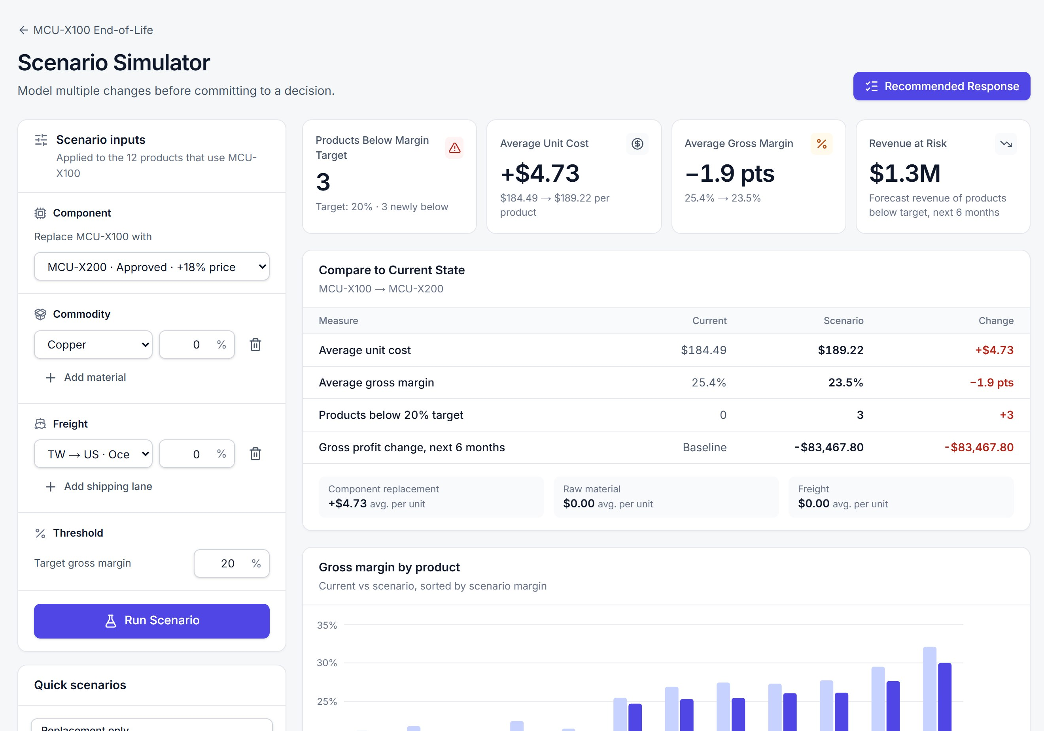
Test a decision before you make it
PRODUCT · SCENARIO SIMULATOR
Swap parts, move copper and freight, set the margin target
Cost and margin recalculated for every product
See which products fall below target, and why
Live product on Google Cloud · fictional demo data
08
Notes:
The scenario simulator lets a planner stack changes: a replacement part, a commodity move, a freight lane increase, and a margin target. Every number is recalculated deterministically, with the change attributed to replacement, material and freight.

Slide 9
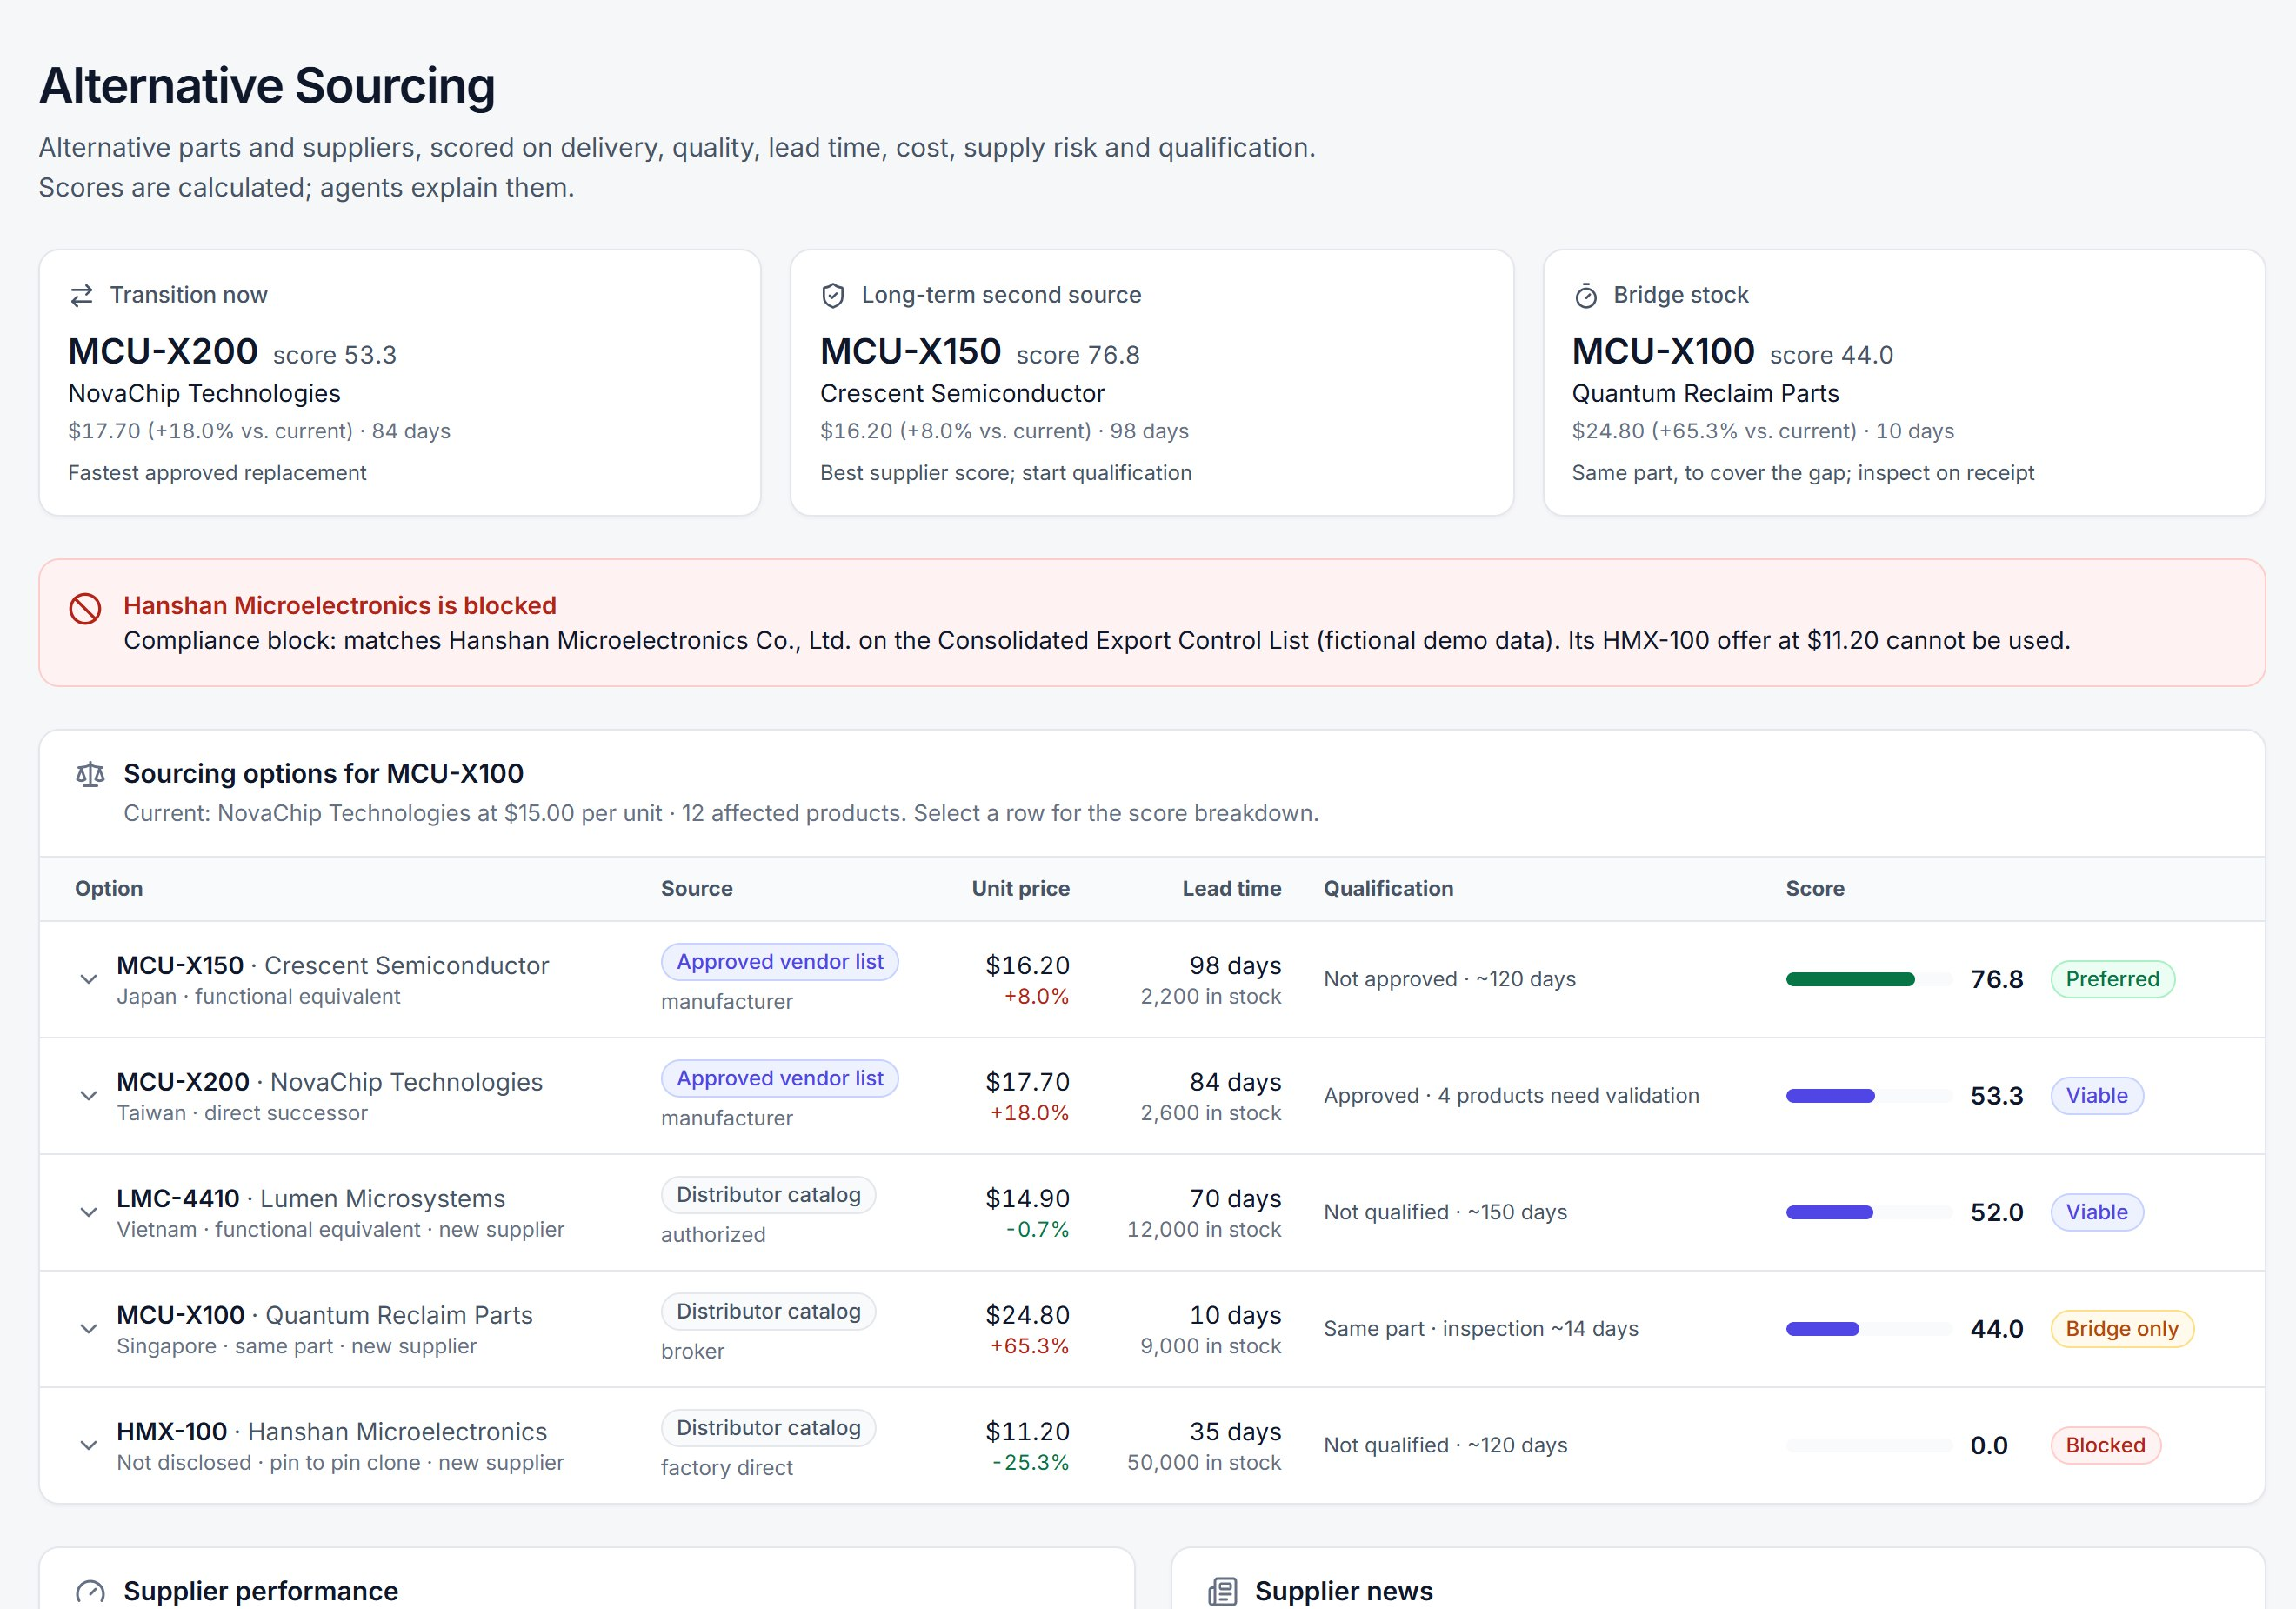
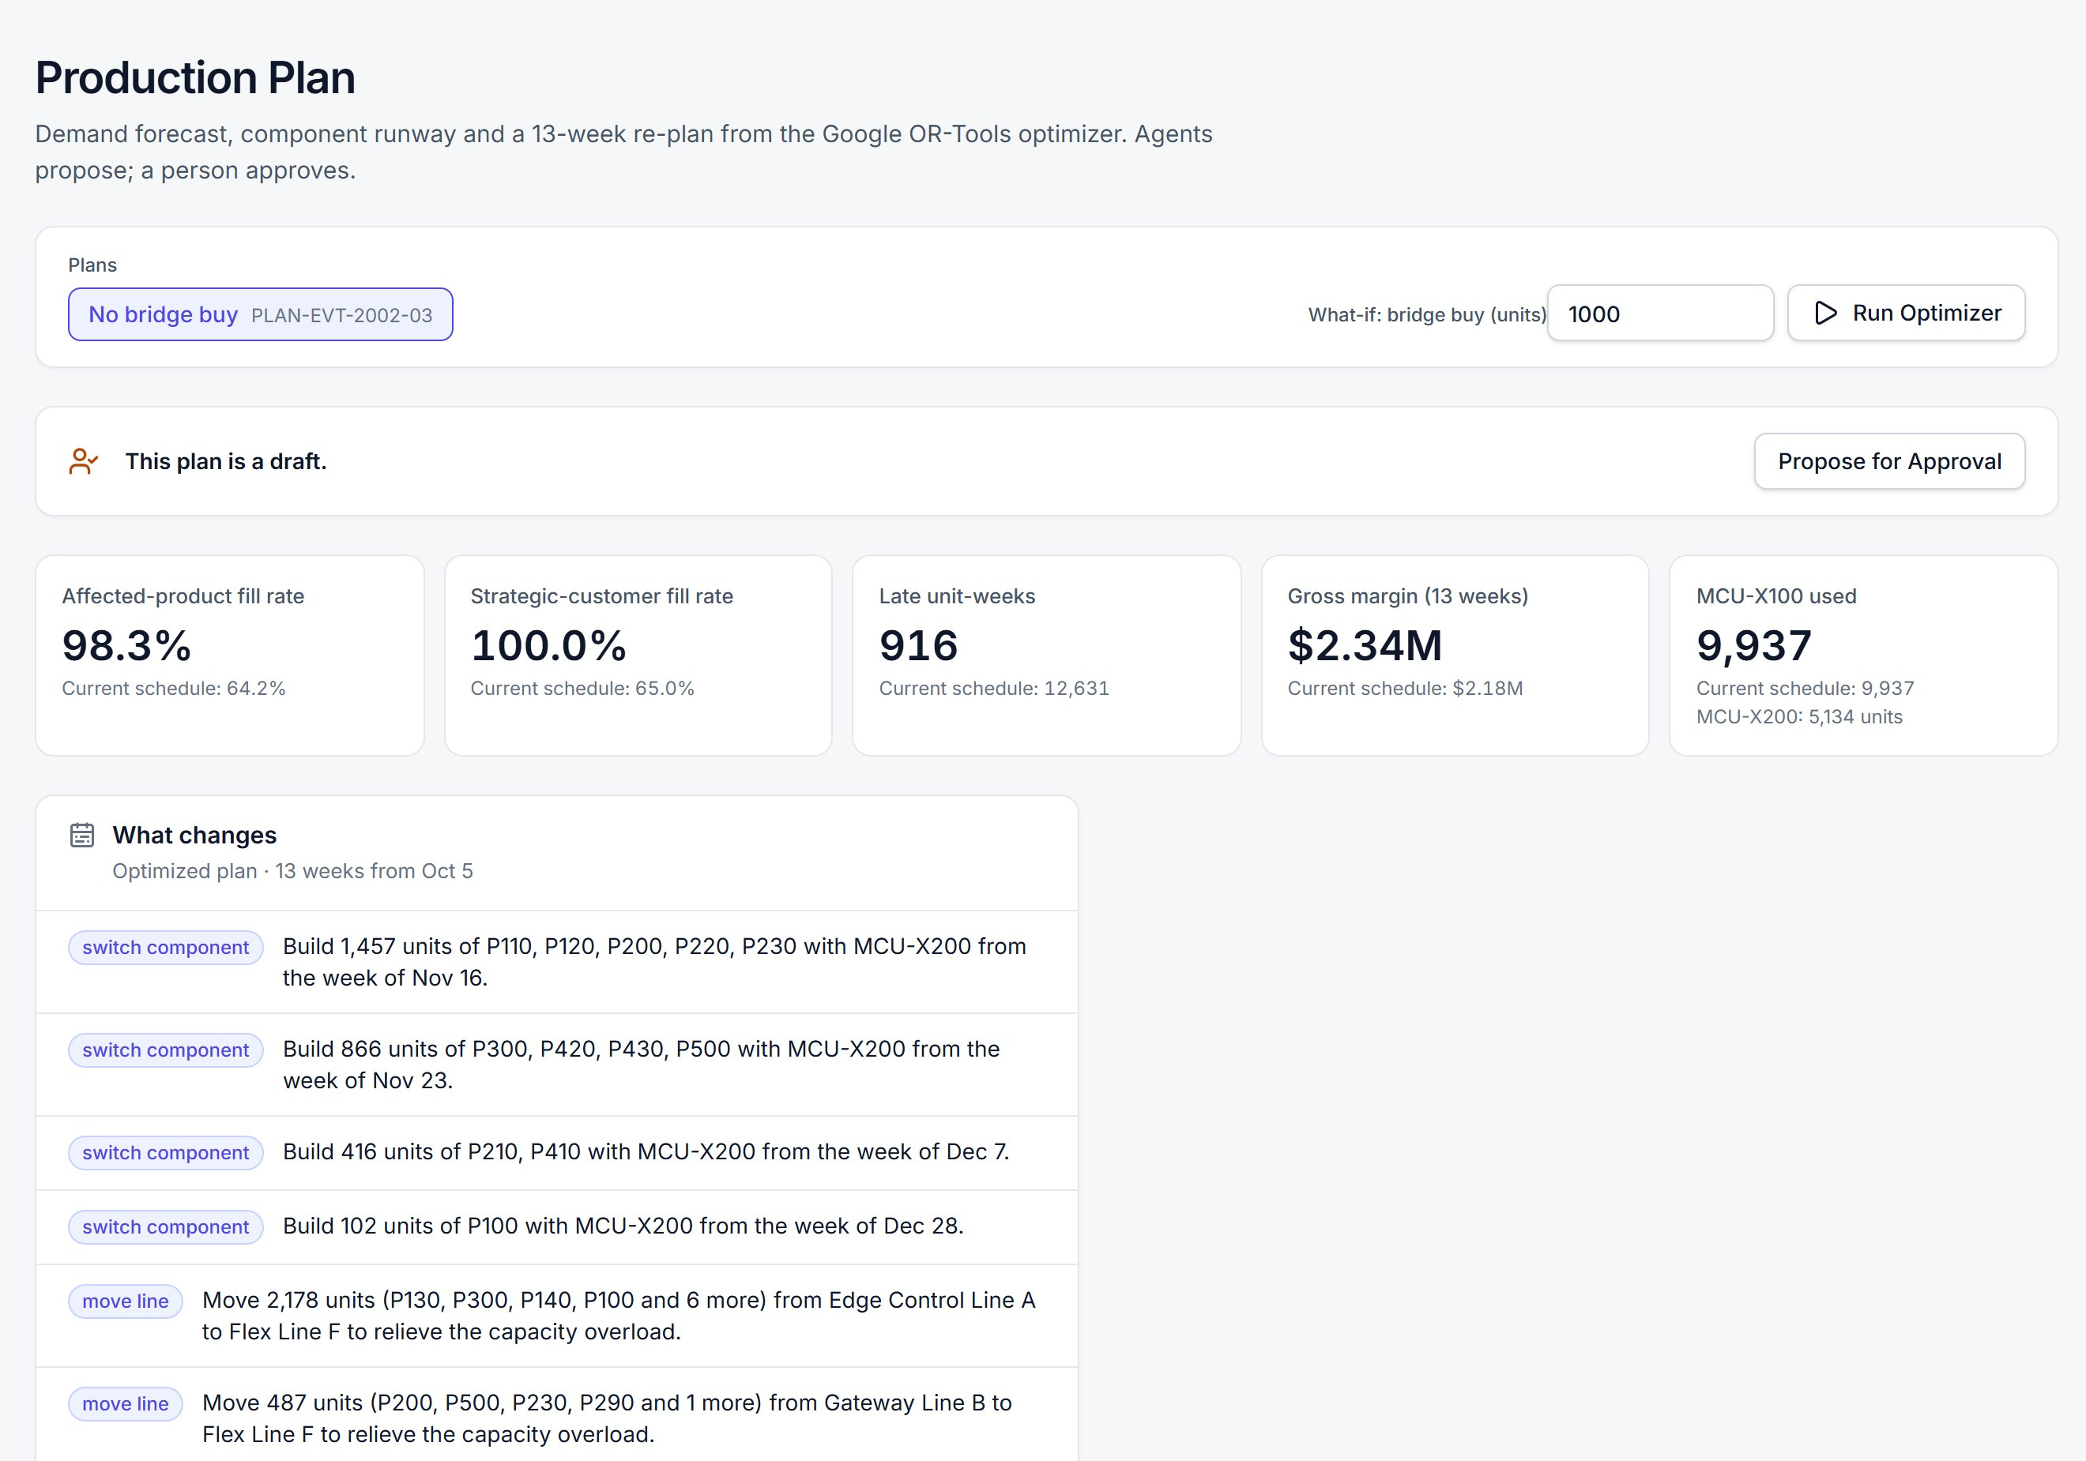
Find the next supplier. Re-plan the line.
PRODUCT · SOURCING AND PRODUCTION PLAN
Every alternate supplier scored, with a sanctions block
OR-Tools re-plans 13 weeks of production; a person approves
Live product on Google Cloud · fictional demo data
09
Notes:
Sourcing merges the approved vendor list with distributor cross-references and scores each option on delivery, quality, lead time, cost, supply risk and qualification, behind a compliance gate. Planning forecasts demand with BigQuery AI.FORECAST and re-plans lines and weeks with OR-Tools CP-SAT. The plan stays a draft until a person approves it.

Slide 10

Nine AI agents work the case for you
GEN AI IMPLEMENTATION
TWO TEAMS IN PARALLEL
Sourcing team · 5 agents
Scout finds options → three due-diligence agents check performance, sanctions and supplier news in parallel → evaluator scores each supplier
Response coordinator
Impact analyst
Traces the BOM and sizes the exposure
Writes the brief and the action plan
Planning team · 2 agents
Demand planner forecasts with TimesFM → production planner re-plans with OR-Tools and proposes a plan
Sequential and parallel agents share findings through ADK session state
Every agent and tool step streams live to the UI
The production plan is only proposed: a person approves it
Gemini 2.5 Flash on Vertex AI · Google Agent Development Kit
10
Notes:
AI is the workflow, not a chat box on the side. Gemini-powered ADK agents decide which tools to call and in what order, run research in parallel, and hand findings to each other. Humans stay in the loop for the decision that matters: approving the production plan.

Slide 11
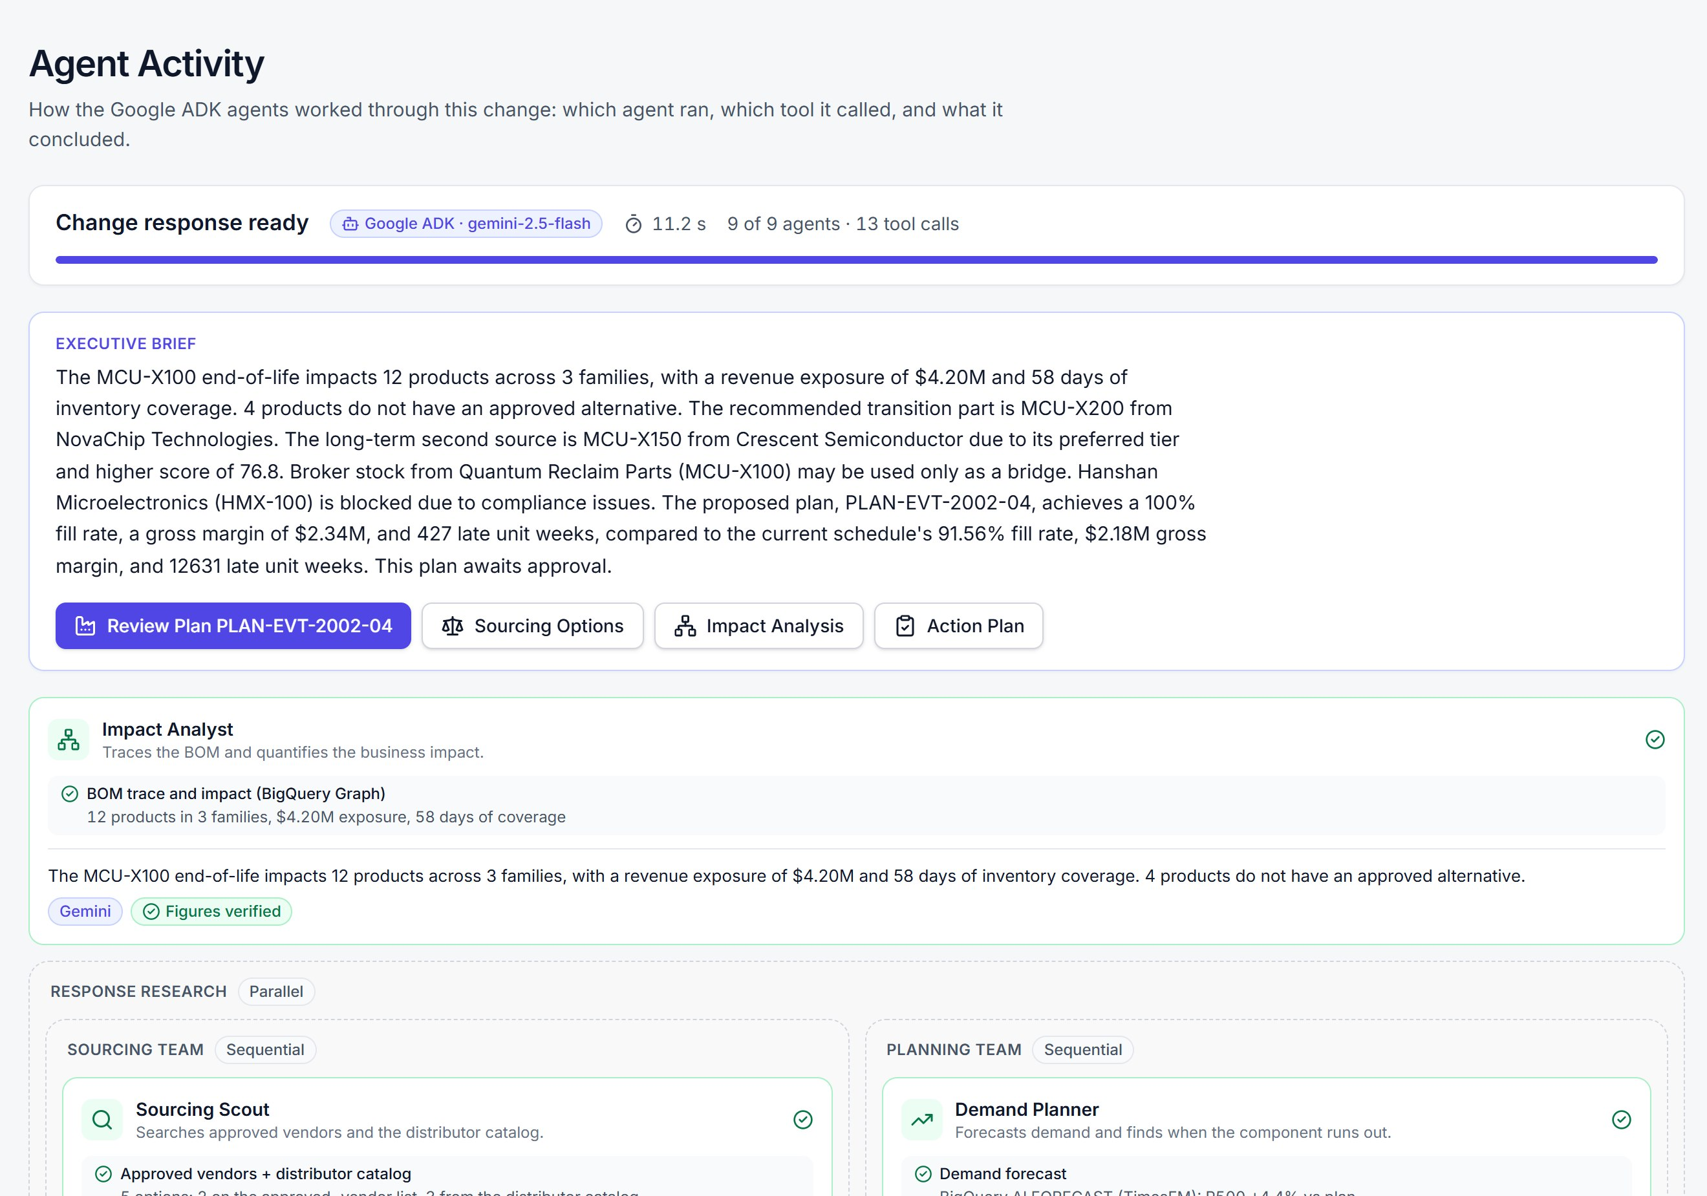
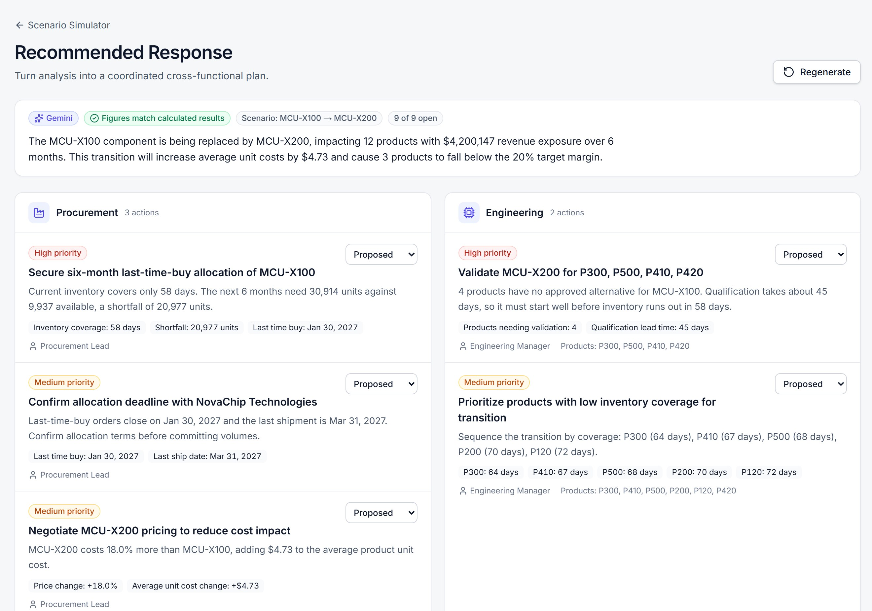
Every team gets its next move
PRODUCT · AGENT BRIEF AND RESPONSE PLAN
Nine agents deliver one executive brief, figures verified
Actions by department, each citing the facts behind it
Live product on Google Cloud · fictional demo data
11
Notes:
The Agent Activity page streams each agent and tool call as it runs, then shows the executive brief with a link to review the proposed plan. The Recommended Response turns it into owned, prioritized actions for procurement, engineering, finance and sales, each with the calculated facts it rests on.

Slide 12




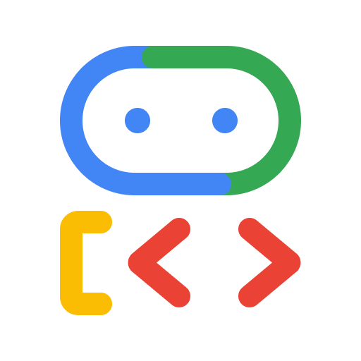







Built end to end on Google Cloud and Google AI
ARCHITECTURE
API SERVICE · CLOUD RUN
Vertex AI
Google ADK
Gemini 2.5 Flash
9-agent workflow, FastAPI
Business teams
BigQuery
Cloud Run
Google OR-Tools
Graph · AI.FORECAST
Next.js web app
CP-SAT production re-plan
Browser
Connectors
Deterministic engines
Catalog · sanctions · news
BOM, cost, scenario, risk
Product icons © Google, used to identify Google Cloud services
12
Notes:
The browser talks to a Next.js app on Cloud Run, which proxies to a FastAPI service on Cloud Run running the Google ADK agents. Agents call Gemini 2.5 Flash on Vertex AI to reason and call typed tools to calculate: BigQuery holds the 17 business tables, BigQuery Graph traces the BOM, AI.FORECAST (TimesFM) forecasts demand, and OR-Tools re-plans production. Connectors for distributor catalogs, sanctions screening and supplier news are interfaces with fictional data today.

Slide 13

Numbers your CFO can sign off on
TRUSTWORTHY BY DESIGN · AI REASONS, ENGINES CALCULATE
Gemini via Google ADK | BigQuery, Python and OR-Tools
Reads supplier notices into structured events | Multi-level BOM trace with BigQuery Graph
Chooses which tools to call, and in what order | Cost roll-up, gross margin and scenarios
Decides whether a bridge buy is worth testing | Production re-plan with OR-Tools CP-SAT
Explains forecasts, scorecards and plans | Demand forecast with BigQuery AI.FORECAST
Writes findings, the brief and action wording | Supplier scores, compliance gate, risk levels
Grounding guardrail: every number an agent writes is checked against tool output. Anything ungrounded falls back to the calculated finding.
RippleOps · AI Builder Cup 2026
13
Notes:
Finance and procurement cannot act on a number a language model guessed. So Gemini never does business arithmetic: it reads, plans, chooses tools and explains. Quantities, costs and margins come from deterministic code, and a guardrail checks every figure in AI text against tool output. Without Gemini the same tools still run with calculated findings.

Slide 14
Built for the teams that keep products shipping
WHO BENEFITS
PROCUREMENT
ENGINEERING
PLANNING
FINANCE & SALES
Last-time-buy size and a scored alternate supplier
Exactly which assemblies need re-validation
A re-plan that keeps lines running and customers served
Margin impact before prices are re-quoted
FOR MANUFACTURING AND THE SUPPLY CHAIN
Faster, shared answers mean fewer line stoppages, fewer surprise shortages for customers, and more resilient supplier networks.
RippleOps · AI Builder Cup 2026
14
Notes:
Every action in the response plan cites the calculated facts behind it, so each team starts from the same numbers. People move from reconciling spreadsheets to making the call. Across manufacturing and its supplier networks, earlier and shared answers mean disruptions are handled before they reach the customer.

Slide 15
Not a concept. It runs today.
FEASIBILITY
Live on Cloud Run
Gemini 2.5 Flash
BigQuery Graph
Web app and agent API, deployed and public
On Vertex AI: notice extraction, agent workflow and assistant
17 tables; the BOM is traced with a GQL property-graph query
83 tests
9 of 9 agents
Safe fallback
Unit, integration and API tests; demo figures asserted in CI
The full ADK workflow runs live, with every step streamed
Without Gemini, the same tools run in order with calculated findings
RippleOps · AI Builder Cup 2026
15
Notes:
This is not a mock-up. The prototype is deployed on Cloud Run, reads from BigQuery, traces the BOM with BigQuery Graph and runs Gemini on Vertex AI. Recursive SQL is the fallback for the graph query, and the whole app also runs locally without any cloud credentials.

Slide 16
One engine for every change in the supply chain
SCALABILITY
Enterprise scale
Real systems
Every change
BigQuery and BigQuery Graph handle enterprise-size BOMs. Cloud Run scales the services on demand.
Connectors are interfaces today. DigiKey, Mouser, OpenSanctions or a news API plug into the same contract.
The same loop covers tariffs, commodity spikes, freight disruption and supplier failure.
Next: ERP and PLM connectors · write-back of approved actions · continuous monitoring of supplier feeds
RippleOps · AI Builder Cup 2026
16
Notes:
Any manufacturer built on multi-level bills of materials can use the same approach: electronics, automotive, industrial equipment, medical devices. The agents and engines don't change; only the data and connectors do.

Slide 17

The team behind RippleOps
TEAM
[Name]
[Name]
[Name]
[ROLE]
[ROLE]
[ROLE]
[One line on background and what they built]
[One line on background and what they built]
[One line on background and what they built]
RippleOps · AI Builder Cup 2026
17
Notes:
Introduce the team and why we care about this problem.

Slide 18

One change. Every impact.
One decision.
RIPPLEOPS
Live demo rippleops-web-273776274235.us-central1.run.app
Code github.com/victorchangwork052/rippleops
Notes:
Thank you. The prototype is live on Google Cloud and the code is open on GitHub; all demo data is fictional.

